Slide 1
Tree Building Exercise:
Men in Hats…
NOTE: Play this PowerPoint in SLIDE SHOW mode

Slide 2


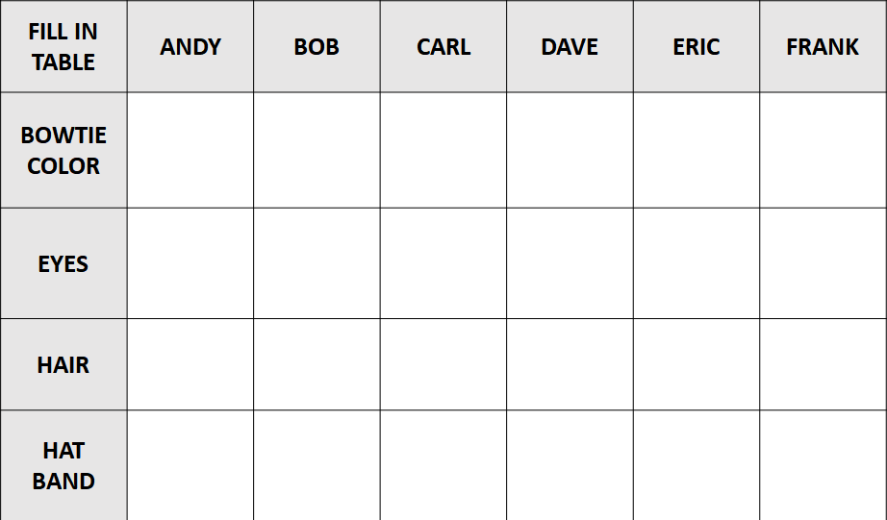


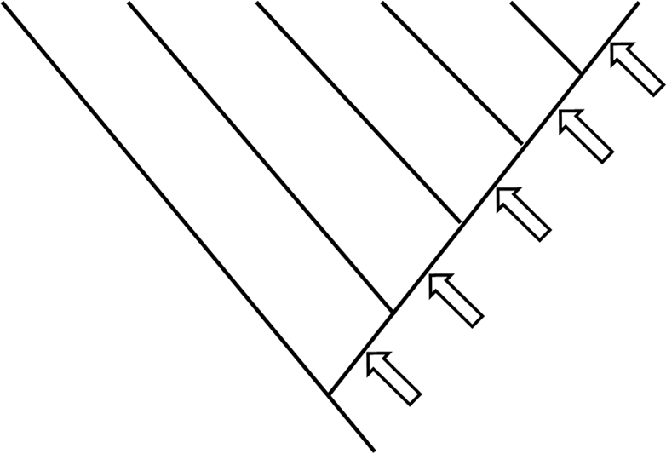


OUTGROUP

Slide 3
Build a cladogram (family tree) depicting their evolutionary relatedness
6 hypothetical individuals with different characters
How do you do that???
OUTGROUP

Slide 4
Start off by filling in the matrix with the characters for each individual
FILL IN TABLE | ANDY | BOB | CARL | DAVE | ERIC | FRANK
BOWTIE COLOR | RED | BLUE | RED | BLUE | GREEN | RED
EYES | BROWN | BROWN | BROWN | BROWN | BROWN | BLUE
HAIR | BLONDE | BROWN | BROWN | BROWN | BROWN | BLONDE
HAT BAND | NO | YES | NO | NO | NO | NO

Slide 5

OUTGROUP
Character only 1 person has and no one else does (or everyone else does and this character does not)
Character FRANK + ANDY + CARL + another share and no one else does (or FRANK + ANDY + CARL + another lack and everyone else has)
Character FRANK + ANDY + another share and no one else does (or FRANK + ANDY + another lack and everyone else has)
Hat
band
APPEARS
Character FRANK + another share and no one else does (or FRANK + another lack and everyone else has)
But WHICH character would be placed on the tree?
Is there a character FRANK has and no one else does or a character FRANK does NOT have and everyone else does
Blue bow
tie APPEARS
Red bowtie, Blue eyes, Blonde hair, and
Non-banded hat are all ANCESTRAL states
Green bow
tie APEARS
Green bow
tie APPEARS
Blue bow
tie APEARS
5 character states
Brown hair
APPEARS
Are all of the arrows used???
Which one goes where???
Brown eyes
APPEAR

Slide 6
+
HAT
BAND
+
BLUE
BOWTIE
+
GREEN
BOWTIE
ANSWER KEY
You will see problems like this on the EXAM. Make sure you understand how to construct these trees if given a matrix (data table) OR create the matrix and tree given a set of items.
BROWN
HAIR
+
+
BROWN
EYES

